Slide 1
MATH
Machine Learning
LAB 3
Bharuno Mahesworo

Slide 2
How to LAB?
Download this PPT
Follow the instruction
Screen shoot your code and its result of each instruction, then put it on the instruction slide.
Submit your slide deck and notebook file
Googling is permitted
Using Communication platform (email, discord, social media, etc.) is prohibited
Submit to:
bharuno.mahesworo@binus.ac.id
Before the end of the LAB.
Subject: ML_(class code)_(LAB session)_NIM
Example: ML_LZ99_LAB1_12345
File name format: ML_(class code)_(LAB session)_NIM
Example: ML_LZ99_LAB1_12345

Slide 3
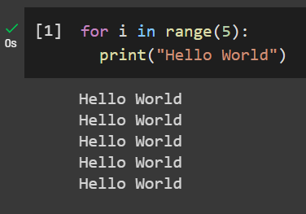
Print Hello World 5 times using loops
Example
Instruction
Your compiled codes
hint
for loops or while loops

Slide 4
LAB 3 – Classification Credit Scoring
The objective of the dataset is to diagnostically predict whether a person unable to return the loan or not, based on certain score measurements included in the dataset. “dataset_CS.csv” can be downloaded from binusmaya
Target Variable
Target: 0 (can repay the loan) or 1 (cannot repay the loan)

Slide 5
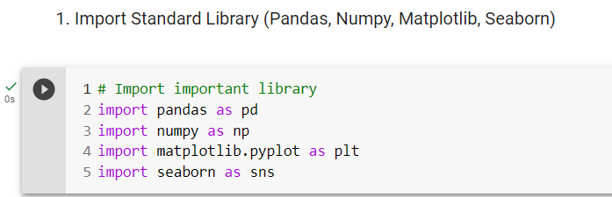
1. Import Standard Library (Pandas, Numpy, Matplotlib, Seaborn)

Slide 6
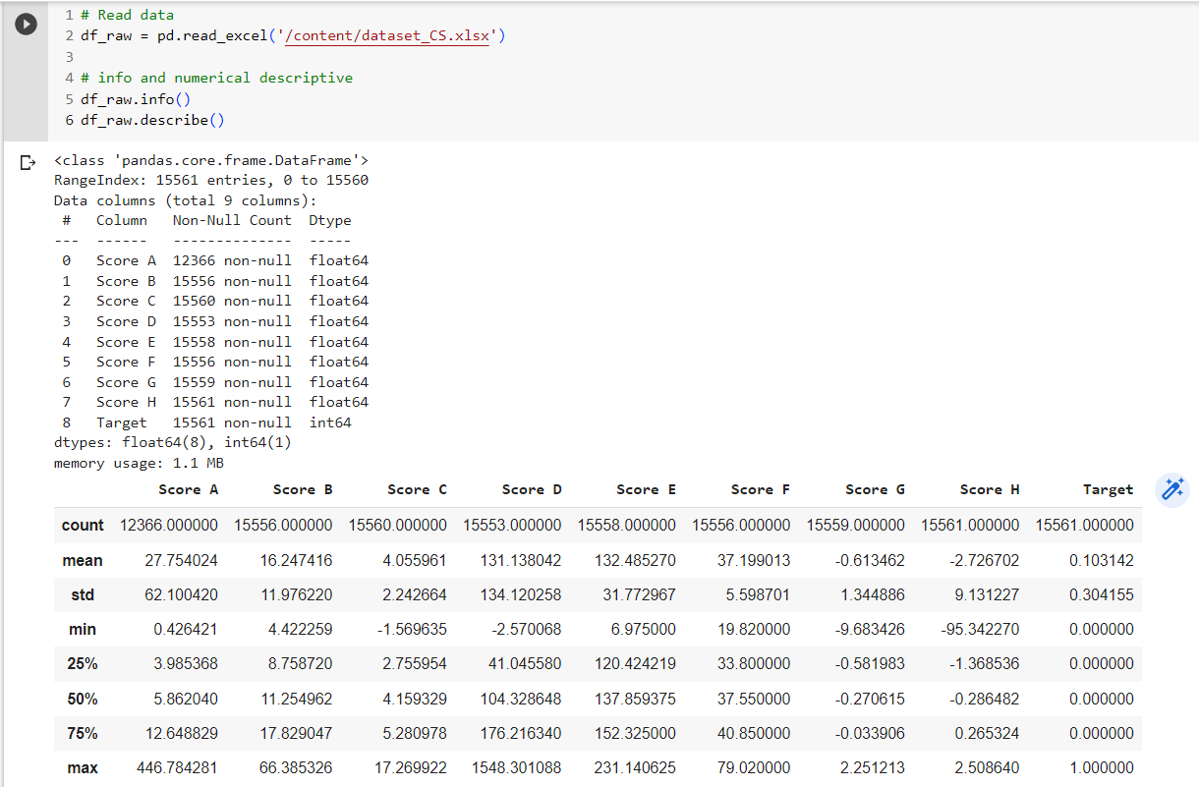
2. Import or Read data into a DF variable with the name of “df_raw” then show its information and numerical descriptive data!
.info(), .describe()

Slide 7
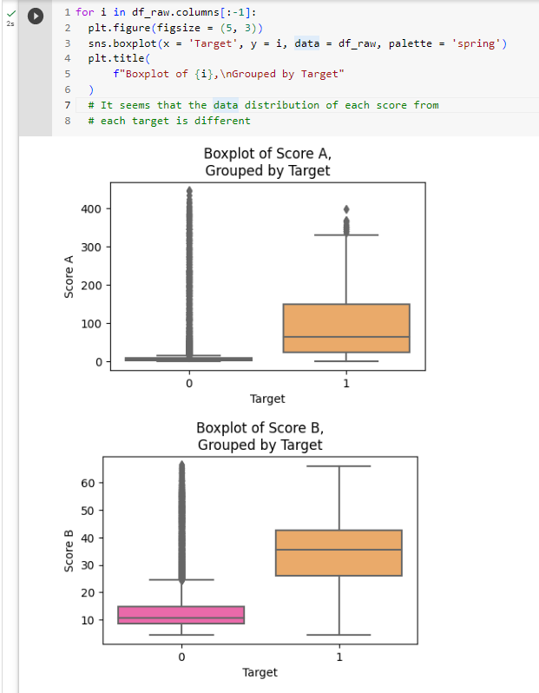
3. Do data exploration on all features using chart, put proper name on each chart!
boxplot

Slide 8
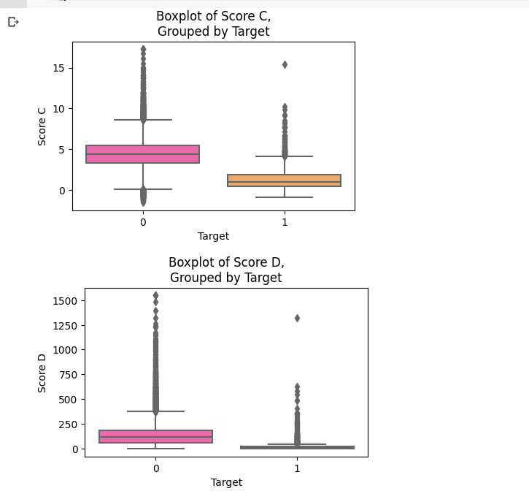
3. Do data exploration on all features using chart, put proper name on each chart!
boxplot

Slide 9
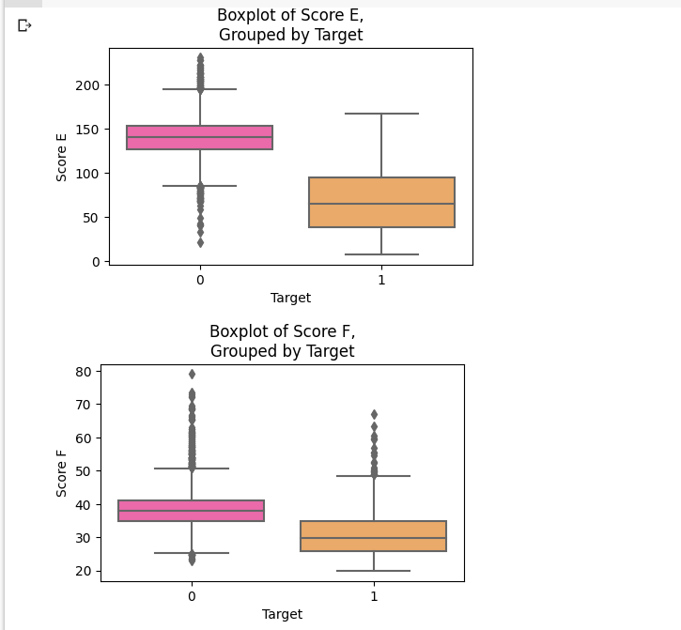
3. Do data exploration on all features using chart, put proper name on each chart!
boxplot

Slide 10
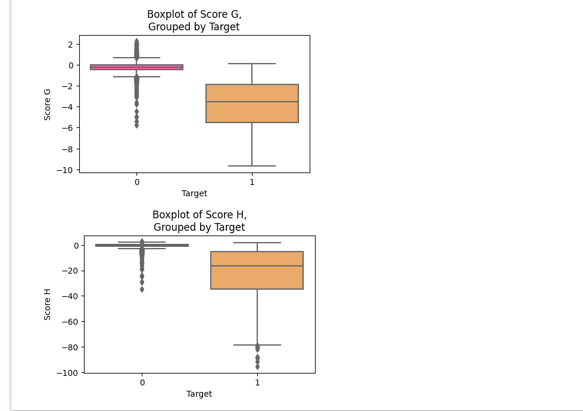
3. Do data exploration on all features using chart, put proper name on each chart!
boxplot

Slide 11
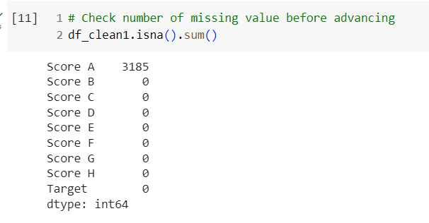
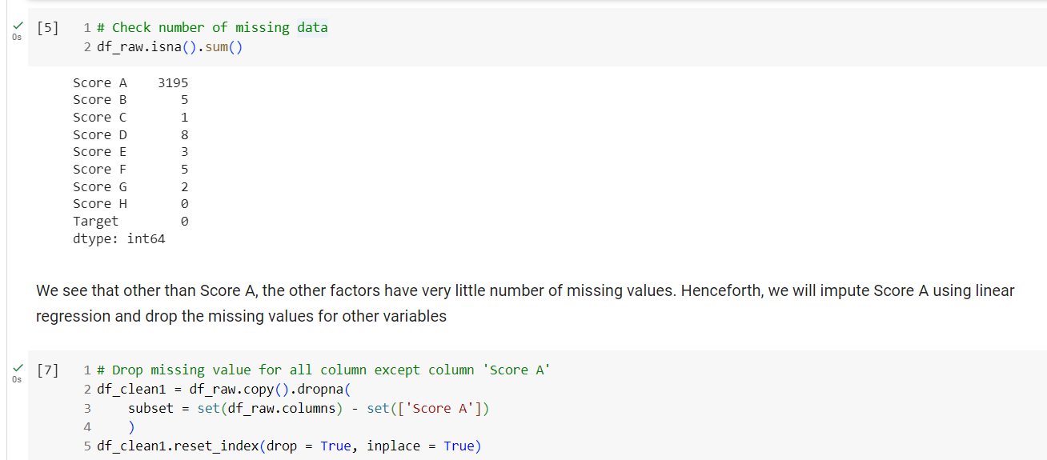
4. Handle missing data!
Dropna, regression

Slide 12
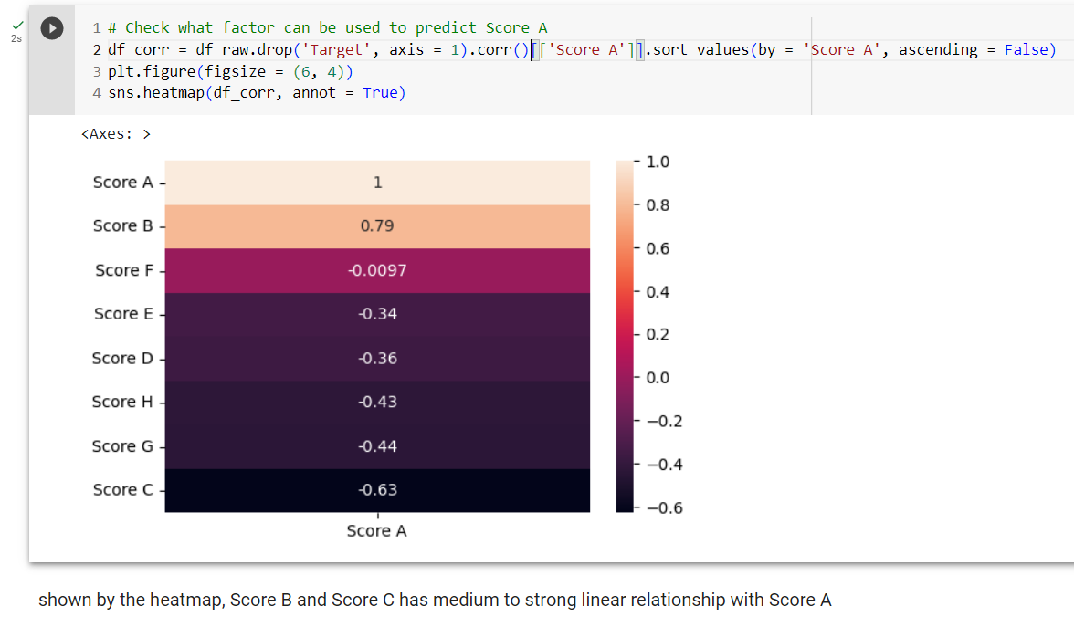
4. Handle missing data!
Dropna, regression

Slide 13
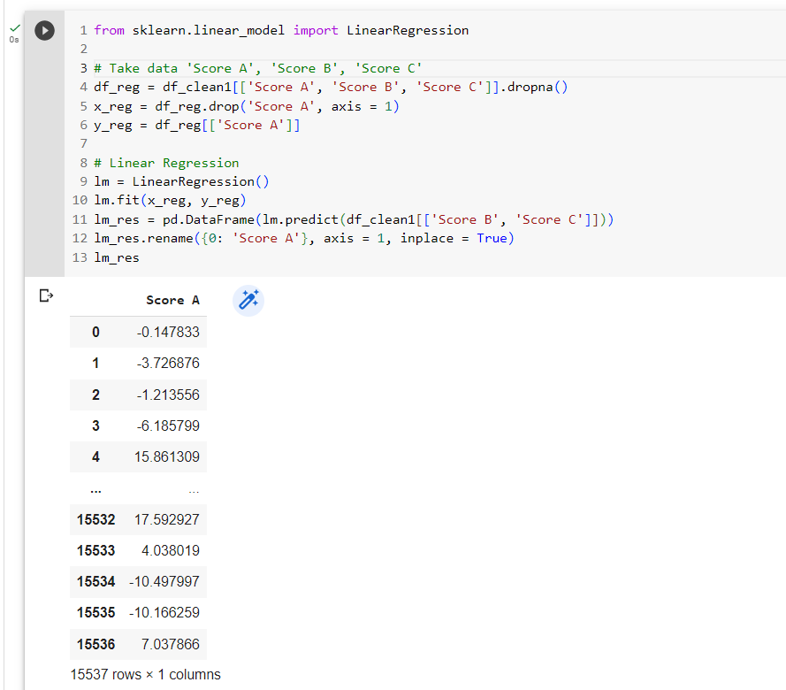
4. Handle missing data!
Dropna, regression

Slide 14
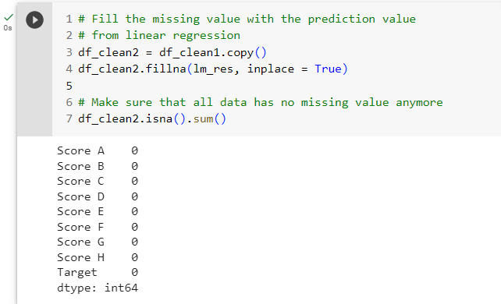
4. Handle missing data!
Dropna, regression

Slide 15
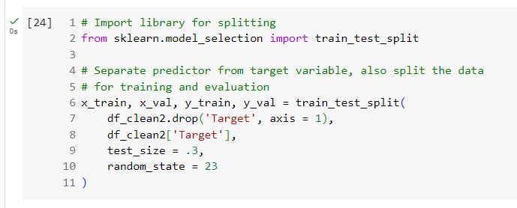
5. Separate the predictors from the target variable and split the dataset into training and validation sets!
train_test_split()

Slide 16
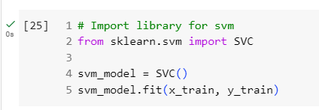
6. Train SVM!
SVC

Slide 17
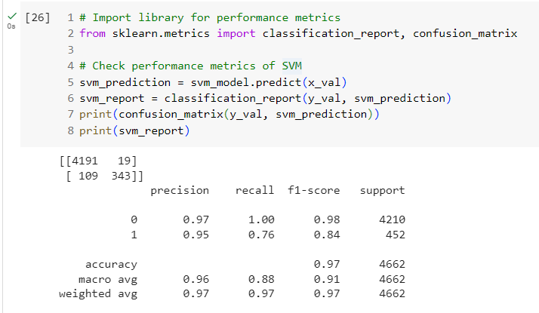
7. Show SVM model validation performance metrics!
classification_report()

Slide 18
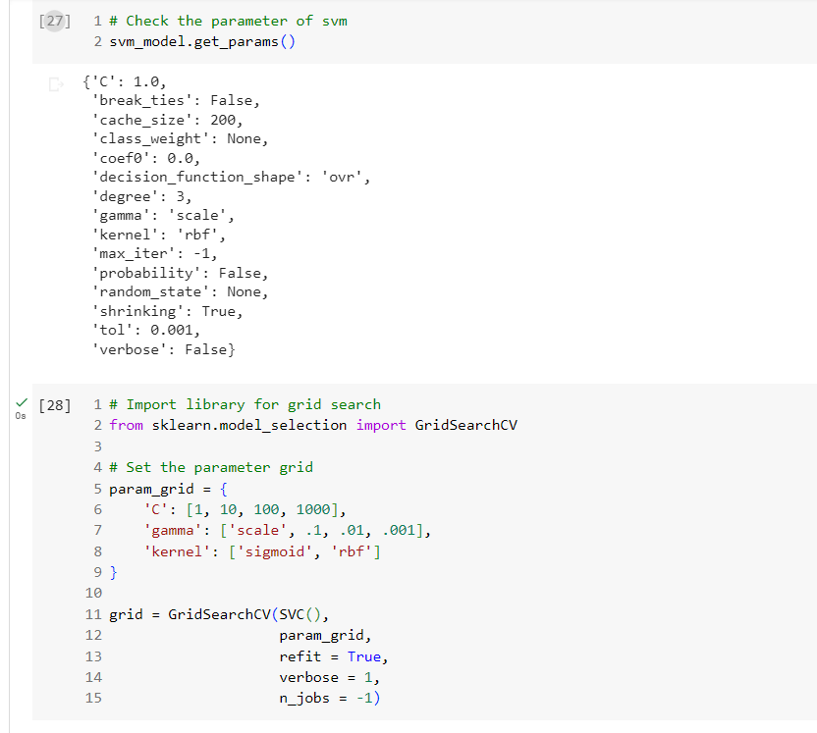
8. Hyperparameter tunning, then show the validation performance using best parameter result from hyperparameter tunning.
classification_report()

Slide 19
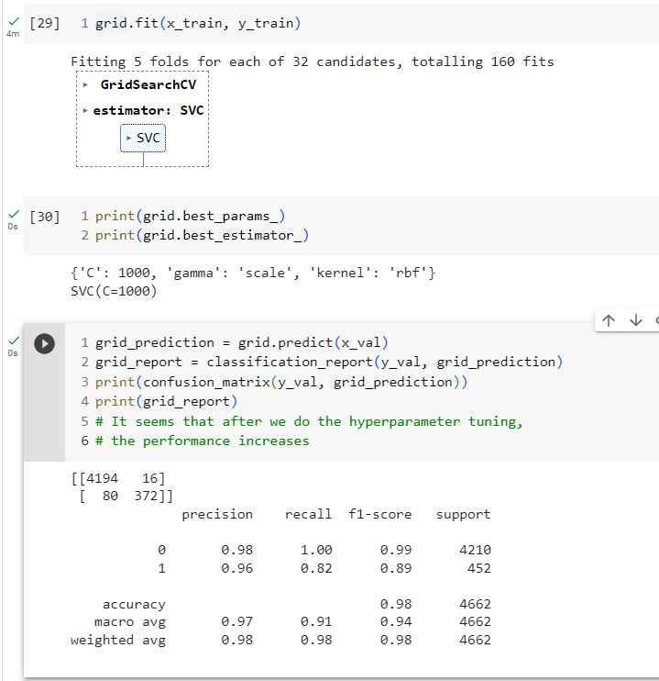
8. Hyperparameter tunning, then show the validation performance using best parameter result from hyperparameter tunning.
classification_report()

Slide 20
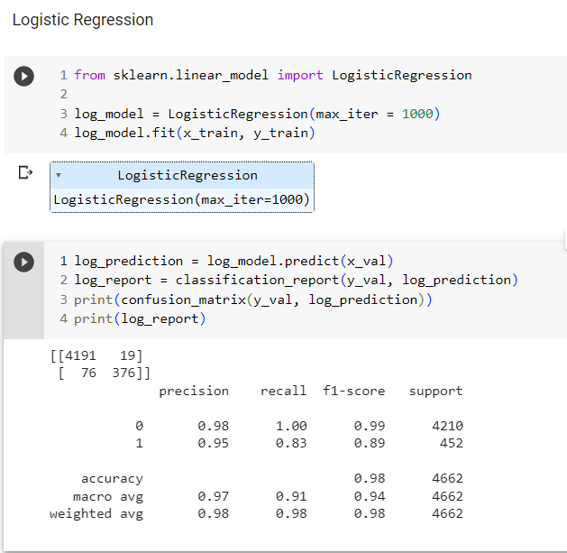
9. Train two other classification model and show the validation performance!

Slide 21
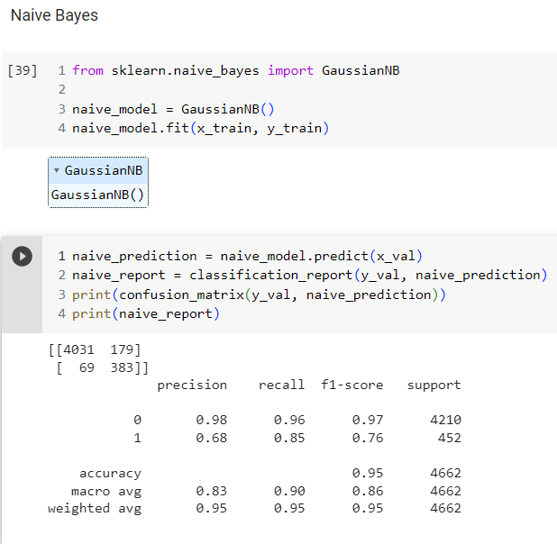
9. Train two other classification model and show the validation performance!

Slide 22
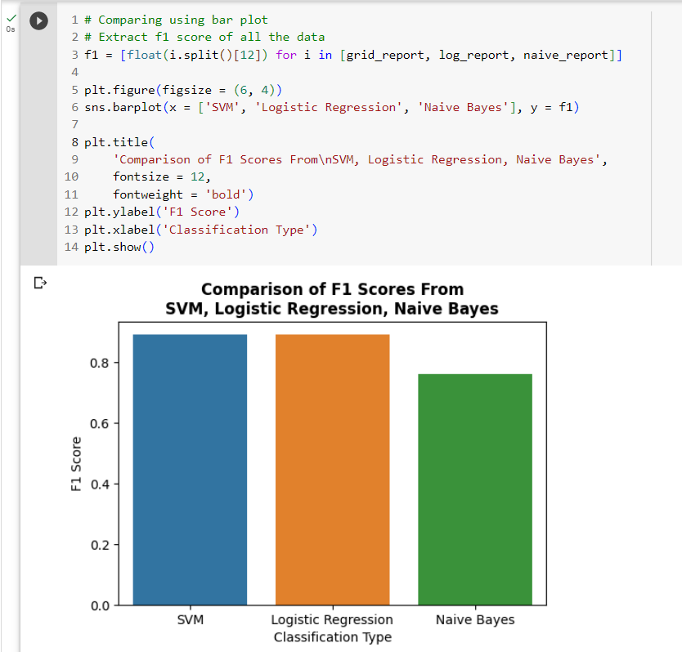
10. Compare the performance of all model using chart!

